Slide 1
TELECOMMUNICATIONS IN THE INTER-NETWORKED ENTERPRISE
1-2.1 The Telecommunications Revolution
The Merging of Computers and Communications
Trends in Telecommunications
Industry Trends
Technology Trends
Application Trends
1-2.2 How Organizations use Telecommunications for Competitive Advantage
1-2.3 The Business value of Telecommunications Networks
1-2.4 Electronic Data Interchange
1-2.5 Groupware

Slide 2
NETWORKED ENTERPRISES AND THE INTERNET
2-2.1 Enterprise Networking
2-2.2 The Role of Intranets
2-2.3 The Role of Extranets
2-2.4 The Internet Revolution

Slide 3
The Internetworked Enterprise
When computers are networked, two industries - computing and communications - converge, and the result is vastly more than the sum of the part.
Suddenly, computing applications become available for business-to-business coordination and commerce, and for small as well as large organization.
The global Internet creates a public place without geographic boundaries – cyberspace - where ordinary citizens can
interact,
publish their ideas, and
engage in the purchase of goods and service.
In short, the impact of both computing and communications on our society and organizational structures is greatly magnified .

Slide 4
The Telecommunications Revolution
Telecommunications can be defined as the communication (or exchange) of information in any form (voice, data, text, images, audio, video) by electronic means, usually over some distance.
Telecommunications revolution has two components:
rapid changes in the technology of communications
important changes in the ownership, control, and marketing of telecommunications services.

Slide 5
The Merging of Computers and Communications
The information superhighway is described as high-speed digital telecommunications networks that are national or worldwide in scope and accessible by the general public rather than restricted to use by members of a specific organization or set of organizations such as a corporation.

Slide 6
This is a vast web of high-speed digital telecommunications networks delivering
information,
education, and
entertainment services to offices and homes.
has already had profound impact on economic and social life as railroads and interstate highways did in the past.
The concept of the information superhighway involves
new ways to obtain and disseminate information that virtually eliminate the barriers of time and place.
The most well known and easily the largest implementation of this concept, (the information superhighway) is the Internet.

Slide 7
Another aspect of the information superhighway is the national computing network proposed by the U.S. federal government.
It is envisioned that this network will link
universities,
research centers,
libraries,
hospitals, and
other institutions
that need to exchange vast amounts of information while being accessible in homes and schools.

Slide 8
Trends in Telecommunications
Industry Trends
Telecommunications was a monopoly of either the state or a regulated private firm.
In the United States, American Telephone and Telegraph (AT&T) was the largest regulated monopoly, providing virtually all telecom services.
Monopoly ended in 1984 leading to
Widening of the market for new telecommunications technologies and devices,
cheaper long-distance service
telephone answering equipment, cellular telephones, and private satellite services.
AT&T itself started marketing computing services and computing equipment.

Slide 9
The competitive arena for telecommunications service has changed dramatically in many countries in recent years.
The telecommunications industry has changed from government-regulated monopolies to a deregulated market with fiercely competitive suppliers of telecommunications services.
Numerous companies now offer businesses and consumers a choice of everything from
local and global telephone services to
communications satellite channels,
mobile radio, cable TV, cellular phone services, and Internet access.

Slide 10
Deregulation and the marriage of computers and communications has also made it possible for the telephone companies to expand from traditional voice communications into new information services, such as
providing transmission of news reports, stock reports, television programs, and movies.
The telecommunications revolution has allowed the telephone companies created by the breakup of AT&T to move into the information service business.

Slide 11
The explosive growth of the Internet and the World Wide Web has spawned a host of new telecommunications products, services, and providers.
Driving and responding to this growth, business firms have dramatically increased their use of the Internet and the Web for electronic commerce and collaboration.
Thus, the service and vendor options available to meet a company's telecommunications needs have increased significantly, as have a business manager's decision-making alternatives.

Slide 12
Technology trends
Open systems with unrestricted connectivity, using Internet networking technologies as their technology platform, are today's primary telecommunications technology drivers.
A few examples include
Web browser suites,
HTML Web page editors,
Internet and intranet servers and network management software,
TCP/IP Internet networking products, and
network security firewalls
These technologies are being applied in Internet, intranet, and extranet applications, especially those for electronic commerce and collaboration.

Slide 13
This trend has reinforced previous industry and technical moves toward building client/server networks based on an open systems architecture.
Open systems are information systems that use common standards for hardware, software, applications, and networking.
Open systems, like the Internet and corporate intranets and extranets, create a computing environment that is open to easy access by end users and their networked computer systems.
Open systems provide greater connectivity, that is, the ability of networked computers and other devices to easily access and communicate with each other and share information.

Slide 14
Any open systems architecture also provides a high degree of network interoperability.
That is, open systems enable the many different applications of end users to be accomplished using the different varieties of computer systems, software packages, and databases provided by a variety of interconnected networks.
Frequently, software known as middleware may be used to help diverse systems work together.

Slide 15
Telecommunications has also been revolutionized by the rapid change from analog to digital network technologies.
Telecommunication systems have always depended on voice-oriented analog transmission systems designed to transmit the variable electrical frequencies generated by the sound waves of the human voice.
However, local and global telecommunications networks have rapidly converted to digital transmission technologies that transmit information in the form of discrete pulses, as computers do.

Slide 16
This provides
(1) significantly higher transmission speeds,
(2) the movement of larger amounts of information,
(3) greater economy, and
(4) much lower error rates than analog systems.
In addition, digital technologies allow telecommunications networks to carry multiple types of communications (data, voice, video) on the same circuits.

Slide 17
Another major trend in telecommunications technology is a change from reliance on
copper wire-based media and land-based microwave relay systems
to fiber-optic lines and cellular, PCS, communications satellite, and other wireless technologies.
Fiber-optic transmission, which uses pulses of laser-generated light, offers significant advantages in terms of
reduced size and installation effort,
vastly greater communication capacity,
much faster transmission speeds, and
freedom from electrical interference.

Slide 18
Satellite transmission offers significant advantages for organizations that need to transmit massive quantities of data, audio, and video over global networks, especially to isolated areas.

Slide 19
Application Trends
The changes in telecommunications industries and technologies just mentioned are causing a significant change in the business use of telecommunications.
The trend toward more vendors, services, Internet technologies, and open systems, and the rapid growth of the Internet, the World Wide Web, and corporate intranets and extranets dramatically increase the number of feasible telecommunications applications.

Slide 20
Thus, telecommunications networks are now playing vital and pervasive roles in
Web-enabled e-business processes,
electronic commerce,
enterprise collaboration, and other business applications
that support the operations, management, and strategic objectives of both large and small organizations.

Slide 21
The next table shows some of the common tasks performed by computer systems that would be impossible without advanced telecommunications.

Slide 22
Applications | Example | Requirements
Business
On-line data entry | Inventory control | Transactions occurring several times/second, direct response required
On-line text retrieval | Hospital information systems; library systems | Response required in real time; high character volumes
Inquiry/response | Point-of-sale system; airline reservation system; credit checking | Transactions several times/second; in­stant response within seconds
Administrative message switching | Electronic mail | Short response and delivery times (min­utes to hours)
Process control | Computer aided manufacturing (CAM); numeric control of machine tools | Continuous input transactions and on­line responses required
Intercomputer data exchange | International Transfer of bank funds | Infrequent but high-volume bursts of information; transfer of large data blocks; on-line immediate response
Home
Inquiry response | Home banking; shopping; ordering | On-line transactions collected with high frequency
Text retrieval | Home education | High-volume, rapid transmission
Special entertainment | Sports; polling and political participation | High-capacity video and data capabilities

Slide 23
How Organizations Use Telecommunications for Competitive Advantage
Telecommunications has helped eliminate barriers of geography and time, enabling organizations
to accelerate the pace of production,
to speed decision making,
to forge new products,
to move into new markets, and
to create new relationships with customers.

Slide 24
Applications that are facilitated by Telecommunications
Some of the leading telecommunication's applications for communication, coordination, and speeding the flow of transactions, messages, and information throughout business firms are
electronic mail, voice mail, facsimile machines (fax), digital information services, teleconferencing, dataconferencing, videoconferencing, electronic data interchange, and groupware.

Slide 25
ELECTRONIC DATA INTERCANGE
Electronic data interchange (EDI) is the direct computer-to-computer exchange between two organizations of standard business transaction documents such as invoices, bills of lading, or purchase orders.
EDI saves money and time because transactions can be transmitted from one information system to another through a telecommunications network, eliminating the printing and handling of paper at one end and the inputting of data at the other.
.

Slide 26
EDI may also provide strategic benefits by helping a firm lock in customers, making it easier for customers or distributors to order from them rather than from competitors.
EDI differs from electronic mail in that it transmits an actual structured transaction (with distinct fields such as the transaction date, transaction amount, sender’s name, and recipient’s name) as opposed to an unstructured text message such as a letter.

Slide 27
The Business Value of Telecommunications Networks
What business value is created when a company capitalizes on the trends in telecommunications we have just identified?
Use of the Internet, intranets, extranets, and other telecommunications networks can dramatically
cut costs,
shorten business lead times and response times,
support electronic commerce,
improve the collaboration of workgroups,
develop online operational processes,
share resources,
lock in customers and suppliers, and
develop new products and services.

Slide 28
The next figure illustrates how telecommunications-based business applications can help a company overcome
geographic,
time,
cost, and
structural barriers to business success.

Slide 29
Strategic Capabilities | e-Business Examples | Business Value
Overcome geographic barriers: | Use the Internet and extranets to | Provides better customer service by
Capture information about business | transmit customer orders from | reducing delay in filling orders and
transactions from remote locations | traveling salespeople to a corporate | improves cash flow by speeding up
 | data center for order processing and | the billing of customers
 | inventory control
Overcome time barriers: Provide | Credit authorization at the point | Credit inquiries can be made and
information to remote locations | of sale using online POS networks | answered in seconds
immediately after it is requested
Overcome cost barriers: Reduce | Desktop videoconferencing between | Reduces expensive business trips; allows
the cost of more traditional means | a company and its business partners | customers, suppliers, and employees to
of communication | using the Internet, intranets, | collaborate, thus improving the quality
 | and extranets | of decisions reached
Overcome structural barriers: | Business-to-business electronic | Fast, convenient services lock in
Support linkages for competitive | commerce websites for transactions | customers and suppliers
advantage | with suppliers and customers using
 | the Internet and extranets

Slide 30
Groupware
Groupware provides functions and services to support the collaborative activities of work groups.
It includes
software for information sharing, electronic meetings, scheduling, and e-mail, and
a network to connect the members of the group as they work on their own desktop computers, often in widely scattered locations.
The groupware definition of groups is fluid, allowing users to define the work groups, with multiple group definitions allowed.
For example, a manager may define a group of only those people who work for him. A group may be established for all employees dealing with a specific customer. A company-wide group may be established. Of course, an individual will belong to as many of those groups as is appropriate.

Slide 31
Groupware enhances collaboration by allowing the exchange of ideas (in the form of electronic messages) on a given topic.
All the messages on that topic will be saved in a group, stamped with the date, time, and author.
Any group member can review the ideas of others at any time and add ideas of his or her own.
Similarly, individuals can post a document for other members of the group to comment upon or edit.

Slide 32
Members of a group can post requests for help from the group, and any member of the group can respond and can view the responses of other members of the group.
Finally, if a group so chooses, the members of that group can store their work notes on the groupware so that all others in the group can see what progress is being made, what problems occur, and what activities are planned.

Slide 33
NETWORKED ENTERPRISES AND THE INTERNET
2-2.1 Enterprise Networking
2-2.2 The Role of Intranets
2-2.3 The Role of Extranets
2-2.4 The Internet Revolution

Slide 34
NETWORKED ENTERPRISES AND THE INTERNET
Enterprise Networking
The Information Architecture of an organization may be defined as the particular form that information technology takes in an organization to achieve selected goals.
An organization’s information architecture consists of its computer hardware and software, telecommunications links, and data files.
In enterprise networking the components of the information architecture are arranged to place more of the organization’s computing power on the desktop and to create networks that link entire enterprises.

Slide 35
In earlier information systems, mainframes and minicomputers from the same computer manufacturer, using proprietary operating systems, were responsible for most of the firm’s information processing.
Microcomputers and workstations were used independently by individual users or were linked into small localized networks
One can now adopting an enterprise-wide information architecture, by using a mixture of computer hardware supplied by different hardware vendors.

Slide 36
Presently, Large, complex databases that need central storage are found on mainframes, minis, or specialized file servers, while smaller databases and parts of large databases are loaded on microcomputers and workstations.
The system is a network.
Most consist of multiple networks.
A high-capacity backbone network connects many local area networks and devices and may be connected to many external networks like the Internet.
The linking of separate networks (each of which retains its own identity) into an interconnected network is called internetworking.

Slide 37
The Client/Server Model
In enterprise networking, the primary way of delivering computing power to the desk­top is known as the client/server model.
In the client/server model of computing, data and processing power are distributed out into the enterprise rather than being centrally controlled.
Client/server computing splits processing between clients and servers.
Ideally, the user will experience the network as a single system with all functions, both client and server, integrated and accessible.

Slide 38
The user generally interacts directly only with the client portion of the application, typically through a graphical user interface for data input and query a database to retrieve data.
Once the data have been retrieved, the user can analyze and report on them, using fourth-generation packages such as spreadsheets, word processors, and graphics applications available on the client machine on his or her own desktop.

Slide 39
The server satisfies some or all of the user’s request for data and/or functionality and might be a supercomputer, mainframe, or another desktop computer.
Servers store and process shared data and also perform back-end functions not visible to users, such as managing peripheral devices and controlling access to shared databases.

Slide 40
The client/server model requires that application programs be written as two or more separate software components that run on different machines but that appear to operate as a single application.

Slide 41
Limitations of the client/server model.
It is difficult to write software that divides processing among clients and servers, although more and more client/server software is commercially available.
A specific server can get bogged down quickly when too many users simultaneously want service.
Microcomputers with independent processing power are more difficult to coordinate and administer on a network.

Slide 42
The Internet Revolution
The explosive growth of the Internet is a revolutionary phenomenon in computing and telecommunications.
The Internet has become the largest and most important network of networks today, and has evolved into a global information superhighway.
The Internet is constantly expanding, as more and more businesses and other organizations and their users, computers, and networks join its global web.
Thousands of business, educational, and research networks now connect millions of computer systems and users in more than 200 countries to each other.

Slide 43
Worldwide Internet users
 | 2005 | 2010 | 2014ª
World population^{[3]} | 6.5 billion | 6.9 billion | 7.2 billion
Not using the Internet | 84% | 70% | 60%
Using the Internet | 16% | 30% | 40%
Users in the developing world | 8% | 21% | 32%
Users in the developed world | 51% | 67% | 78%
ª Estimate. Source: International Telecommunications Union.^{[4]}

Slide 44
Internet users by region
 | 2005 | 2010 | 2014ª
Africa | 2% | 10% | 19%
Americas | 36% | 49% | 65%
Arab States | 8% | 26% | 41%
Asia and Pacific | 9% | 23% | 32%
Commonwealth of Independent States | 10% | 34% | 56%
Europe | 46% | 67% | 75%
ª Estimate. Source: International Telecommunications Union.^{[4]}

Slide 45
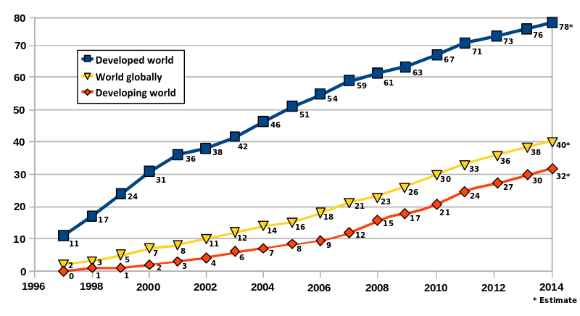
Internet users per 100 inhabitants

Slide 46
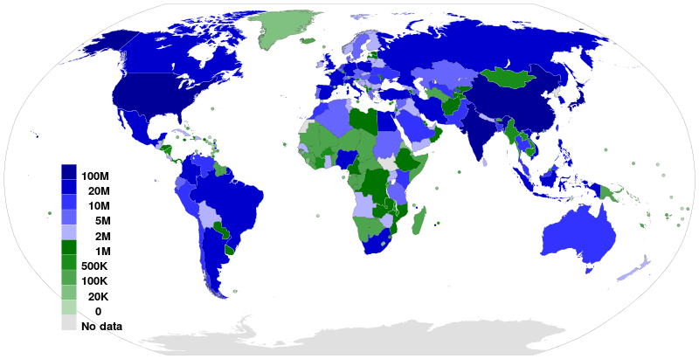
Internet Users WorldMap

Slide 47
The Net doesn't have a central computer system or telecommunications center.
Instead, each message sent has a unique address code so any Internet server in the network can forward it to its destination.
Also, the Internet does not have a headquarters or governing body.
International advisory and standards groups of individual and corporate members (such as
the Internet Society (www.isoc.org) and
the World Wide Web Consortium (www.w3.org)),
promote use of the Internet and the development of new communications standards.
These common standards are the key to the free flow of messages among the widely different computers and networks of the many organizations and Internet service providers (ISPs) in the system.

Slide 48
Popular Uses of the Internet
• Surf. Point and click your way to thousands of hyperlinked websites and resouxces for
multimedia information, entertainment, or electronic commerce.
• E-Mail. Use e-mail and instant messaging to exchange electronic messages with
colleagues, friends, and other Internet users .
• Discuss. Participate in discussion forums of special-interest newsgroups, or hold
real-time text conversations in website chat rooms.
• Publish. Post your opinion, subject matter, or creative work to a website or weblog for
others to read.
• Buy and Sell. You can buy and sell practically anything via e-commerce retailers,
wholesalers, service providers, and online auctions.
• Download. Transfer data files, software, reports, articles, pictures, music, videos, and
other types of files to your computer system.
• Compute. Log on to and use thousands of Internet computer systems around the world.
• Other Uses: Make long-distance phone calls, hold desktop videoconferences, listen to
radio programs, watch television, play video games, explore virtual worlds, etc.

Slide 49
Business Use of the Internet
As the next figure illustrates, business use of the Internet has expanded from an electronic information exchange to a broad platform for strategic business applications.
Notice how applications like collaboration among business partners, providing customer and vendor support, and electronic commerce have become major business uses of the Internet.
Companies are also using Internet technologies for marketing, sales, and customer relationship management applications, as well as cross-functional business applications, and applications in engineering, manufacturing, human resources, and accounting.

Slide 50
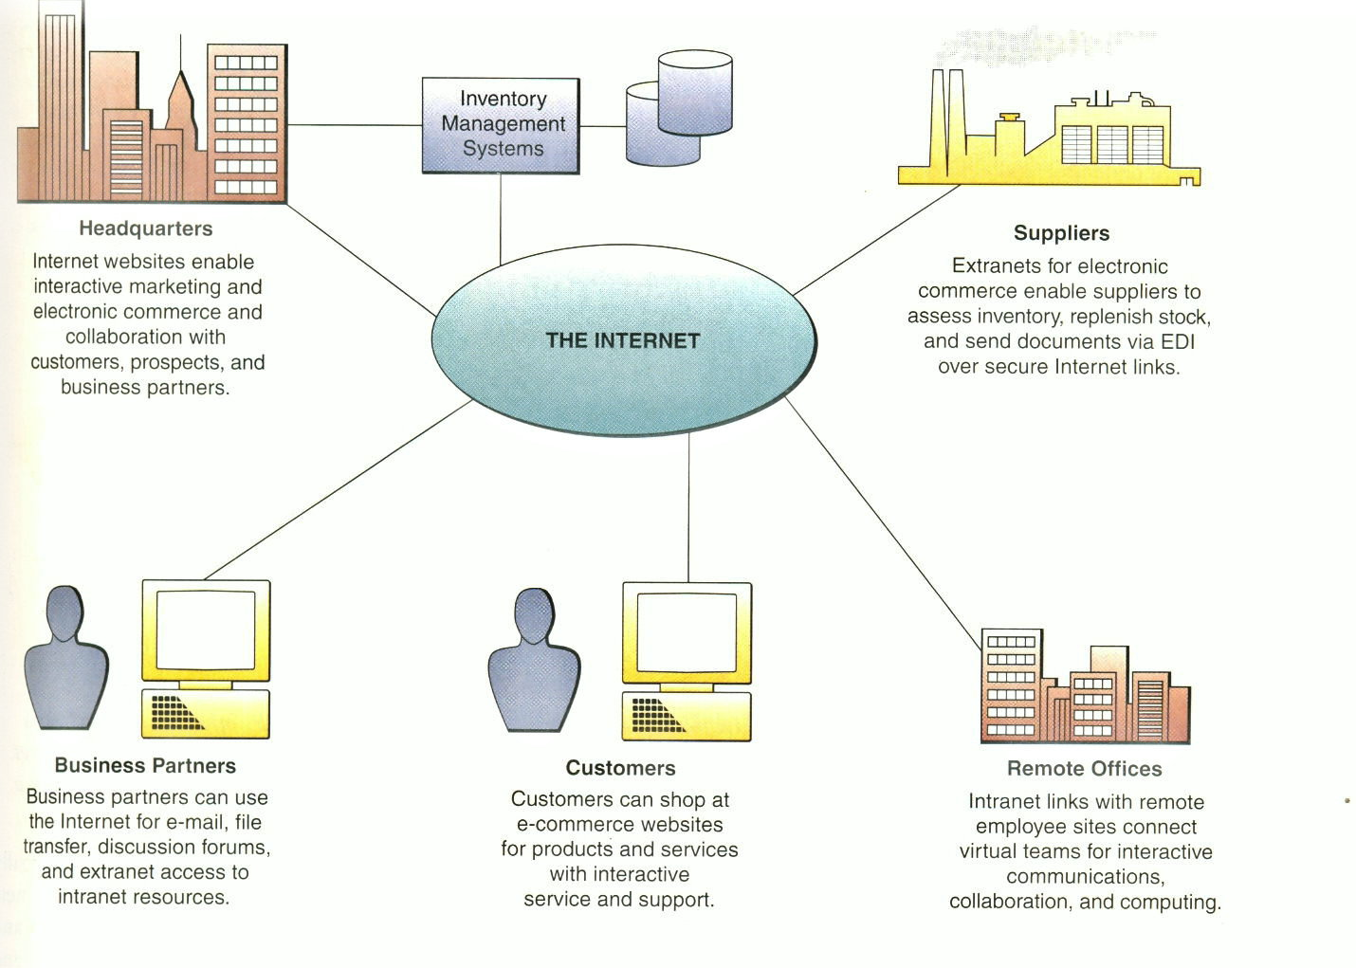

Slide 51
The Business Value of The Internet
The Internet provides a synthesis of computing and communication capabilities that adds value to every part of the business cycle.
What business value do companies derive from their business applications on the Internet?
The figure below summarizes how many companies perceive the business value of the Internet for electronic commerce.

Slide 52
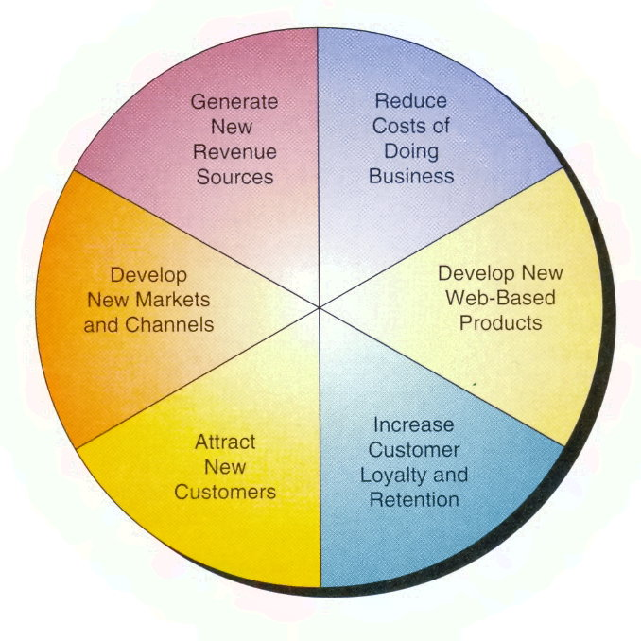

Slide 53
Substantial cost savings can arise because applications that use the Internet and Internet-based technologies (like intranets and extranets) are typically less expensive to develop, operate, and maintain than traditional systems. For example, American Airlines saves money every time customers use their website instead of their customer support telephone system.

Slide 54
Other primary sources of business value include
attracting new customers with innovative marketing and products, and
retaining present customers with improved customer service and support.
Of course, generating revenue through electronic commerce applications is a major source of business value, which we will discuss latter.
To summarize, most companies are building e-business and e-commerce websites to achieve six major business values:

Slide 55
Generate new revenue from online sales.
Reduce transaction costs through online sales and customer support.
Attract new customers via Web marketing and advertising and online sales.
Increase the loyalty of existing customers via improved Web customer service and support.
Develop new Web-based markets and distribution channels for existing products.
Develop new information-based products accessible on the Web

Slide 56
The Role of Intranets
Many companies have sophisticated and widespread intranets, offering detailed data retrieval, collaboration tools, personalized customer profiles, and links to the Internet. Investing in the intranet, they feel, is as fundamental as Supplying employees with a telephone [].

Slide 57
An intranet is a network inside an organization that uses Internet technologies (such as
Web browsers and servers,
TCP/IP network protocols,
HTML hypermedia document publishing and databases, and so on)
to provide an Internet-like environment within the enterprise for information sharing, communications, collaboration, and the support of business processes.

Slide 58
An intranet is protected by security measures such as passwords, encryption, and firewalls, and thus can be accessed by authorized users through the Internet.
A company's intranet can also be accessed through the intranets of customers, suppliers, and other business partners via extranet links.

Slide 59
The Business value of Intranets
One way that companies organize intranet applications is to group them conceptually into a few user services categories that reflect the basic services that intranets offer to their users.
These services are provided by the intranet's portal, browser, and server software, as well as by other system and application software and groupware that are part of a company's intranet software environment.

Slide 60
The next figure illustrates how intranets provide an enterprise information portal that supports
communication and collaboration,
Web publishing,
business operations and management, and
intranet portal management.
Notice also how these applications can be integrated with existing IS resources and applications, and extended to customers, suppliers, and business partners via the Internet and extranets.

Slide 61
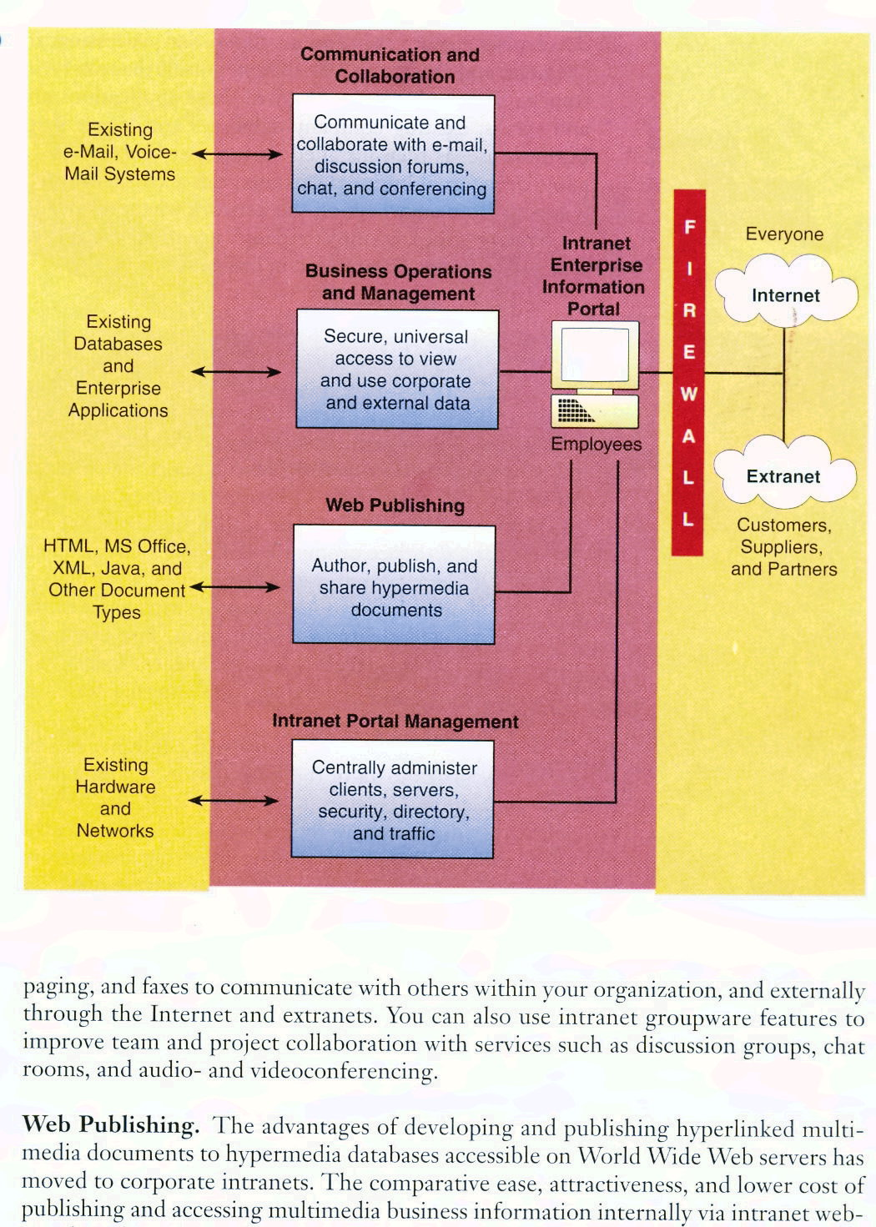

Slide 62
Communications and Collaboration.
Intranets can significantly improve communications and collaboration within an enterprise. For example, you can use your intranet browser and your PC or NC workstation to send and receive e-mail, voicemail, paging, and faxes to communicate with others within your organization, and externally through the Internet and extranets.
You can also use intranet groupware features to improve team and project collaboration with services such as discussion groups, chat rooms, and audio- and videoconferencing.

Slide 63
Web Publishing. The advantages of developing and publishing hyperlinked multi­media documents to hypermedia databases accessible on World Wide Web servers has moved to corporate intranets.
The comparative ease, attractiveness, and lower cost of publishing and accessing multimedia business information internally via intranet web­sites have been the primary reasons for the explosive growth in the use of intranets in business.

Slide 64
For example, information products as varied as company newsletters, technical drawings, and product catalogs can be published in a variety of ways, including hypermedia Web pages, e-mail, and net broadcasting, and as part of in-house business applications.
Intranet software browsers, servers, and search engines can help you easily navigate and locate the business information you need.

Slide 65
Business Operations and Management. Intranets have moved beyond merely making hypermedia information available on Web servers, or pushing it to users via net broadcasting.
Intranets are also being used as the platform for developing and deploying critical business applications to support business operations and managerial decision making across the internetworked enterprise.
For example, many companies are developing custom applications like order processing, inventory control, sales management, and enterprise information portals that can be implemented on intranets, extranets, and the Internet.

Slide 66
Many of these applications are designed to interface with, and access, existing company databases and legacy systems. The software for such business uses is then installed on intranet Web servers. Employees within the company, or external business partners, can access and run such applications using Web browsers from anywhere on the network whenever needed.

Slide 67
The Role of Extranets
As businesses continue to use open Internet technologies [extranets] to improve communication with customers and partners, they can gain many competitive advantages along the way –
in product development,
cost savings,
marketing,
distribution, and
leveraging their partnerships

Slide 68
As we have explained earlier, extranets are network links that use Internet technologies to interconnect the intranet of a business with the intranets of its customers, suppliers, or other business partners.
Companies can establish direct private network links between themselves, or create private secure Internet links between them called virtual private networks.
Or a company can use the unsecured Internet as the extranet link between its intranet and consumers and others, but rely on encryption of sensitive data and its own firewall systems to provide adequate security.
Thus, extranets enable customers, suppliers, consultants, subcontractors, business prospects, and others to access selected intranet websites and other company databases. See figure on next page.

Slide 69
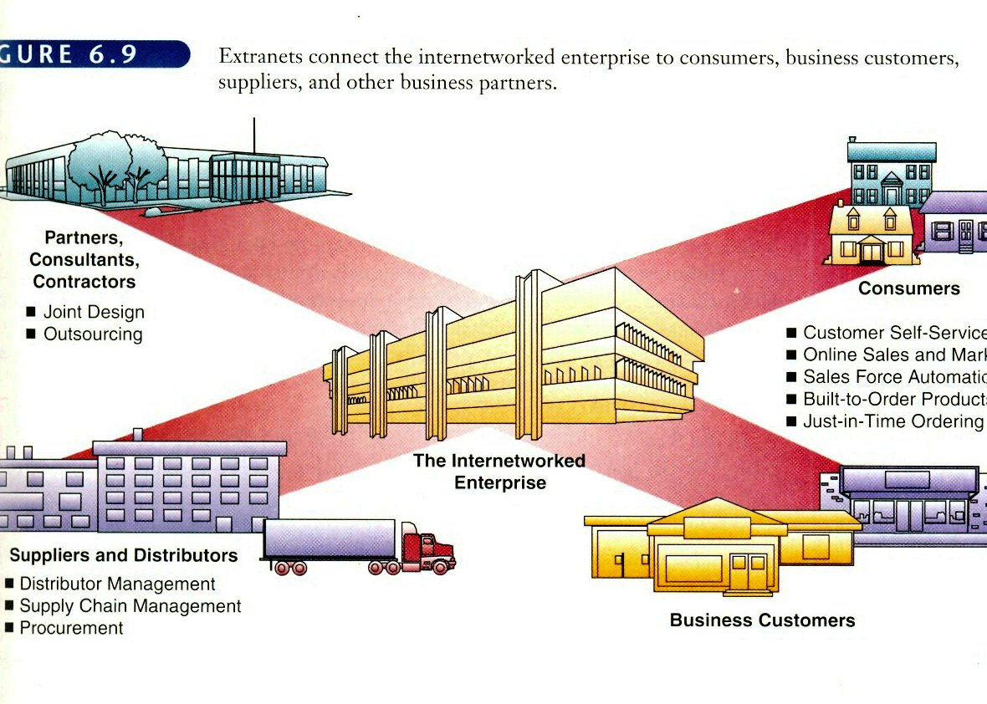

Slide 70
The Business Value of Extranets
The business value of extranets is derived from several factors.
First, the Web browser technology of extranets makes customer and supplier access of intranet resources a lot easier and faster than previous business methods.
Second, extranets enable a company to offer new kinds of interactive Web­enabled services to their business partners.
Thus, extranets are another way that a business can build and strengthen strategic relationships with its customers and suppliers.
They can also, enable and improve collaboration by a business with its customers and other business partners.
Extranets facilitate an online, interactive product development, marketing, and customer-focused process that can bring better-designed products to market faster.

